Slide 1
Time Series: Autoregressive models Backshift Operator and ARIMA(p,0,0)
CP22-24
1 / 77

Slide 2
Autocorrelation and ARIMA Models

Slide 3
ARIMA Models
ARIMA is an acronym that stands for Auto-Regressive Integrated Moving Average. Specifically,
AR Autoregression. A model that uses the dependent relationship between an observation and some number of lagged observations.
I Integrated. The use of differencing of raw observations in order to make the time series stationary.
MA Moving Average. A model that uses the dependency
between an observation and a residual error from a moving average model applied to lagged observations.
Each of these components are explicitly specified in the model as a parameter.
Note that AR and MA are two widely used linear models that work on stationary time series, and I is a preprocessing procedure to “stationarize” time series if needed.
3 / 77

Slide 4
Notations - ARIMA
A standard notation is used of ARIMA(p, d, q) where the parameters are substituted with integer values to quickly indicate the specific ARIMA model being used.
p The number of lag observations included in the model, also called the lag order.
d The number of times that the raw observations are differenced, also called the degree of differencing.
q The size of the moving average window, also called the order
of moving average.
A value of 0 can be used for a parameter, which indicates to not use that element of the model.
In other words, ARIMA model can be configured to perform the function of an ARMA model, and even a simple AR, I, or MA model.
4 / 77

Slide 5
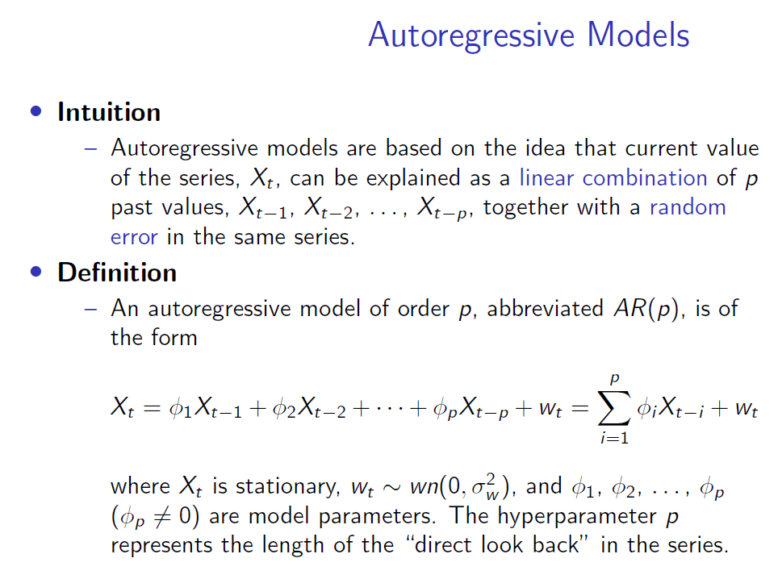

Slide 6
Backshift Operator
We need some new notations to simplify the representations.
Backshift Operator
– The backshift operator is defined as
BX_{t} = X_{t−1}.
It can be extended, B²X_{t} = B(BX_{t} ) = B(X_{t−1}) = X_{t−2}, and so on. Thus,
B^{k} X_{t} = X_{t−k}
.
6 / 77

Slide 7
Forward shift Operator
We need some new notations to simplify the representations.
Backshift Operator
– The backshift operator is defined as
BX_{t} = X_{t−1}.
It can be extended, B²X_{t} = B(BX_{t} ) = B(X_{t−1}) = X_{t−2}, and so on. Thus,
B^{k} X_{t} = X_{t−k}
. Forward-shift operator
We can also define an inverse operator (forward-shift operator ) by enforcing B⁻¹B = 1, such that
X_{t} = B⁻¹BX_{t} = B⁻¹X_{t−1}.
7 / 77

Slide 8
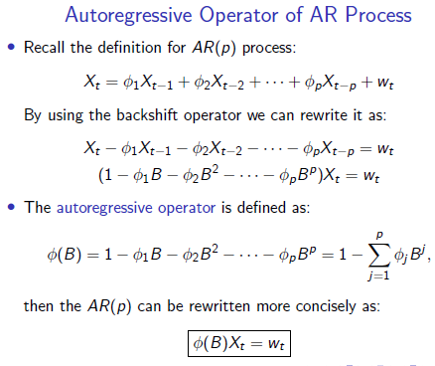

Slide 9
AR Example: AR(0) and AR(1)
The simplest AR process is AR(0), which has no dependence between the terms. In fact, AR(0) is essentially white noise.
AR(1) can be given by X_{t} = φ₁X_{t−1} + w_{t} .
Only the previous term in the process and the noise term contribute to the output.
If |φ₁| is close to 0, then the process still looks like white noise.
If φ₁ < 0, X_{t} tends to oscillate between positive and negative values.
If φ₁ = 1 then the process is equivalent to random walk, which
is not stationary as the variance is dependent on t (and infinite).
9 / 77

Slide 10
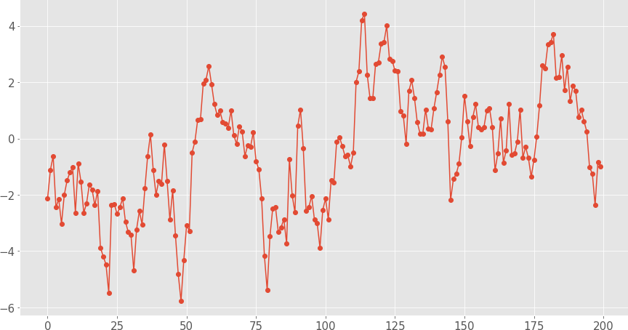
AR Examples: AR(1) Process
Simulated AR(1) Process X_{t} = 0.9X_{t−1} + w_{t} :
Mean
E [X_{t} ] = 0
10 / 77

Slide 11
AR Models: Parameters Estimation
Note that p is like a hyperparameter for the AR(p) process, thus fitting an AR(p) model presumes p is known and only focusing on estimating coefficients, i.e. φ₁, φ₂, . . . , φ_{p} .
There are many feasible approaches:
Method of moments estimator (e.g. Yule-Walker estimator)
Maximum Likelihood Estimation (MLE) estimator
Ordinary Least Squares (OLS) estimator
If the observed series is short or the process is far from stationary, then substantial differences in the parameter estimations from various approaches are expected.
11 / 77

Slide 12
Moving Average Models (MA)
The name might be misleading, but moving average models should not be confused with the moving average smoothing.
Motivation
Recall that in AR models, current observation X_{t} is regressed using the previous observations X_{t−1}, X_{t−2}, . . . , X_{t−p} , plus an error term w_{t} at current time point.
One problem of AR model is the ignorance of correlated noise structures (which is unobservable) in the time series.
In other words, the imperfectly predictable terms in current
time, w_{t} , and previous steps,w_{t−1}, w_{t−2}, . . . , w_{t−q} , are also informative for predicting observations.
12 / 77

Slide 13
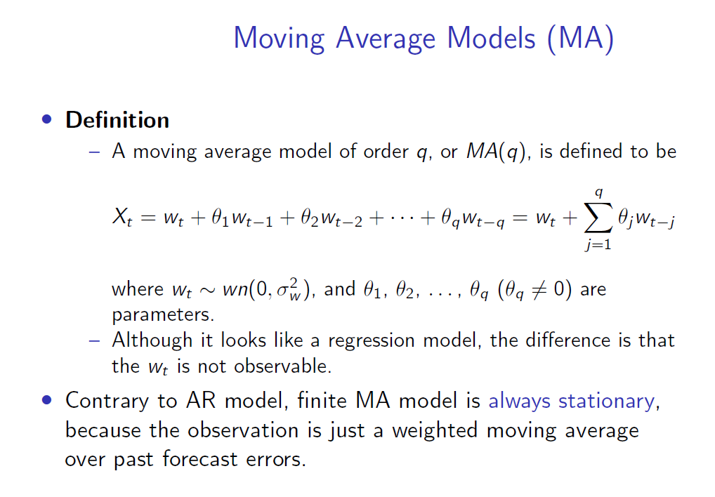

Slide 14
Moving Average Operator
Moving Average Operator
– Equivalent to autoregressive operator, we define moving average operator as:
θ(B) = 1 + θ₁B + θ₂B² + · · · + θ_{q} B^{q},
where B stands for backshift operator, thus B(w_{t} ) = w_{t−1}.
Therefore the moving average model can be rewritten as:
X_{t} = w_{t} + θ₁w_{t−1} + θ₂w_{t−2} + · · · + θ_{q}w_{t−q}
X_{t} = (1 + θ₁B + θ₂B² + · · · + θ_{q} B^{q} )w_{t}
X_{t} = θ(B)w_{t}
14 / 77

Slide 15
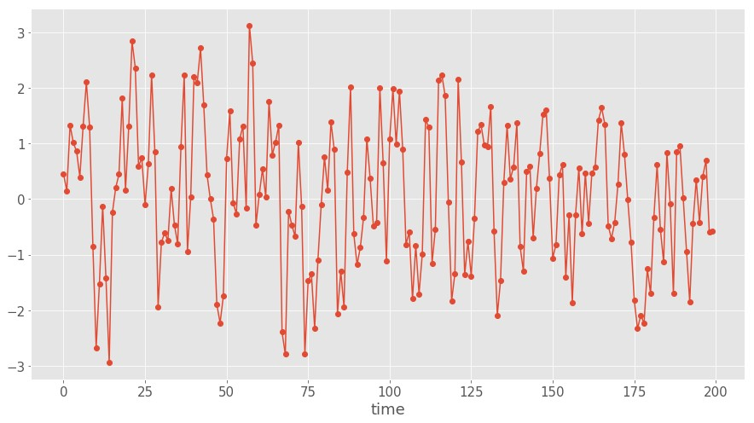
MA Examples: MA(1) Process
Simulated MA(1) Process X_{t} = w_{t} + 0.8 × w_{t−1}:
Mean E [X_{t} ] = 0
15 / 77

Slide 16
General MA(q) Process
An important property of MA(q) models in general is that there are nonzero autocorrelations for the first q lags, and ρ_{h} = 0 for all lags h > q.
In other words, ACF provides a considerable amount of information about the order of the dependence q for MA(q) process.
16 / 77

Slide 17
MA Models: Parameters Estimation
A well-known fact is that parameter estimation for MA model is more difficult than AR model.
– One reason is that the lagged error terms are not observable.
We can still use method of moments estimators for MA process, but we won’t get the optimal estimators with Yule-Walker equations.
In fact, since MA process is nonlinear in the parameters, we need iterative non-linear fitting instead of linear least squares.
From a practical point of view, modern scientific computing software packages will handle most of the details after given the correct configurations.
17 / 77

Slide 18
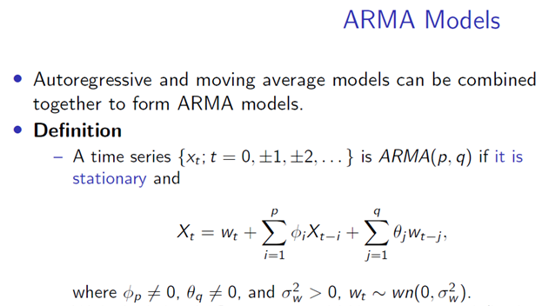

Slide 19
Representation of Differences using Backshift operator
First
Second
Seasonal for monthly and quarterly data

Slide 20
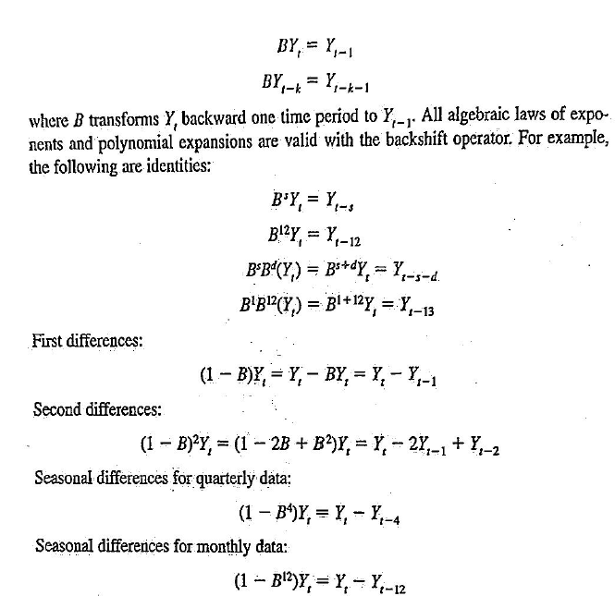

Slide 21
Next lab session
Lab 9: Decompose Time Series Data
Discover time series decomposition with Python.
The structure of decomposing time series into level, trend, seasonality, and noise.
How to automatically decompose a time series dataset with Python.
How to decompose an additive or multiplicative model and plot the results.
21 / 77

Slide 22
Lab Submission & Lab Evaluation
Students to complete Ch 9 to 13 lab assignments by end of next week (Labs7 and 8 already submitted; however do include them in the submission for completion).
Lab evaluation 2 will be on these topics (Chapters 9 to 13 of the book) book - students to be prepared for - 27th October
NB:
Lab 6: Use moving average smoothing for time series forecasting.
Lab 7: Identification of white noise time series
Lab 8: Identification of white random walk time series
Lab 9: Decompose Time Series Data
Lab 10: Use and Remove Trends

Slide 23
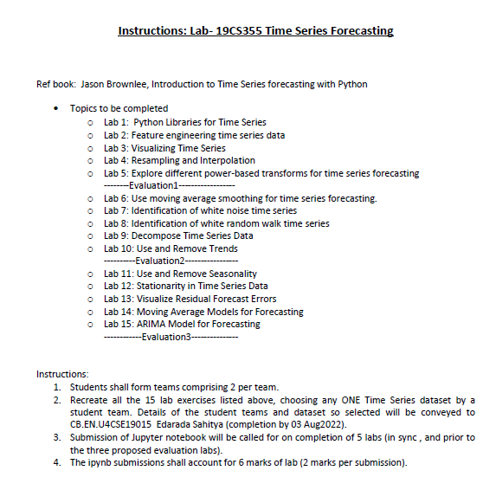

Slide 24
Thank You

Slide 25
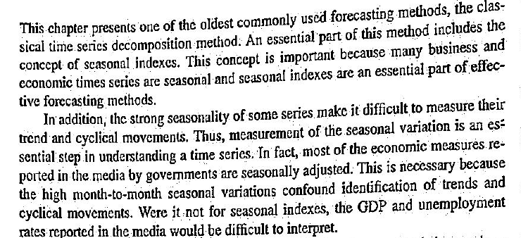

Slide 26
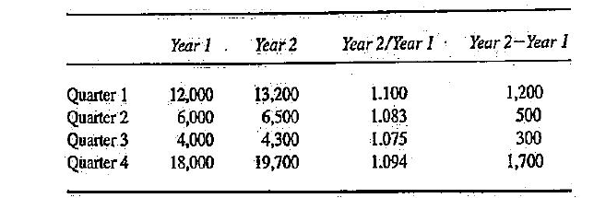

Slide 27
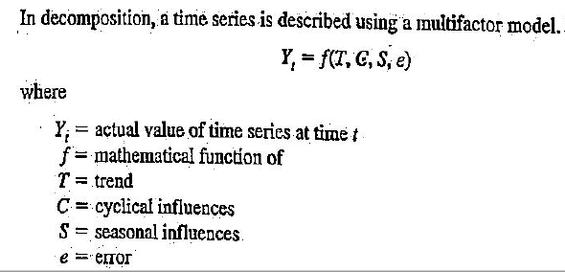
Classical Decomposition Model

Slide 28
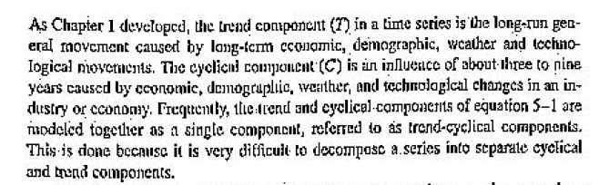

Slide 29
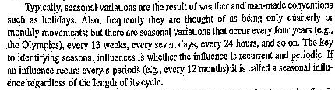

Slide 30
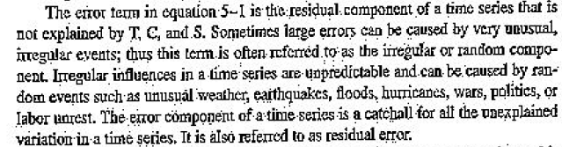

Slide 31
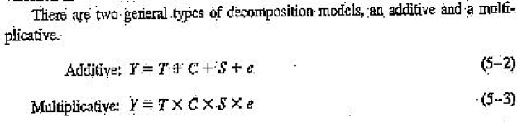

Slide 32
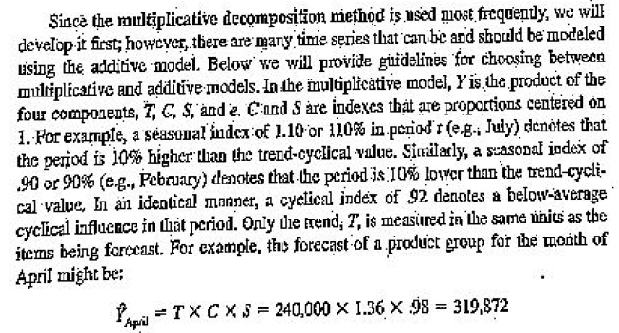

Slide 33
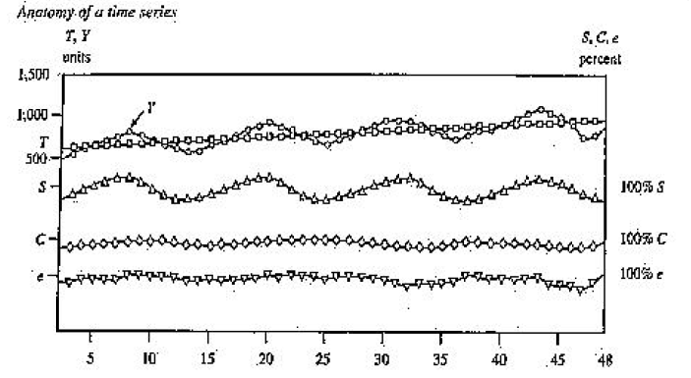

Slide 34
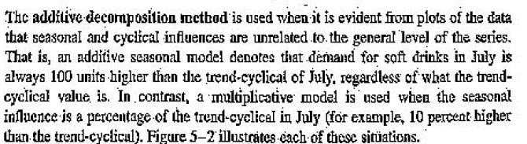
Additive Model

Slide 35
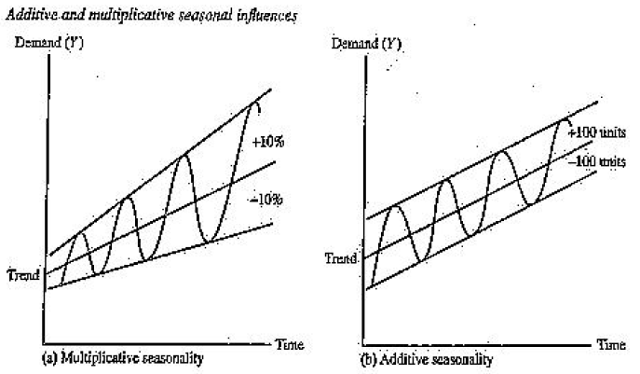

Slide 36
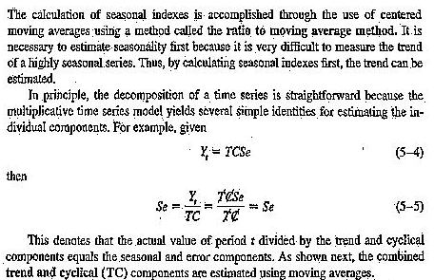

Slide 37
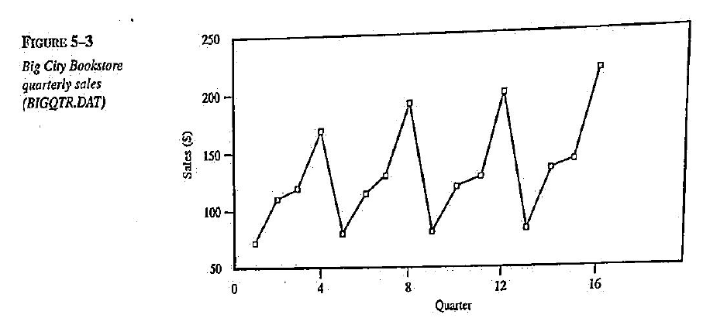

Slide 38
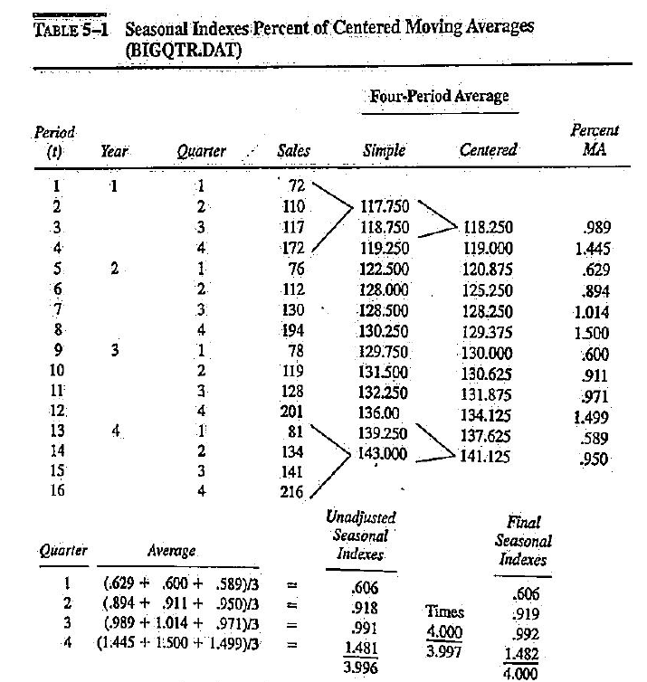

Slide 39
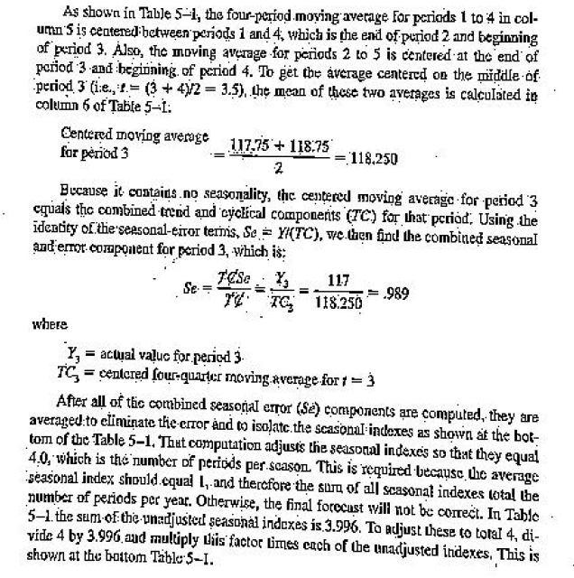

Slide 40
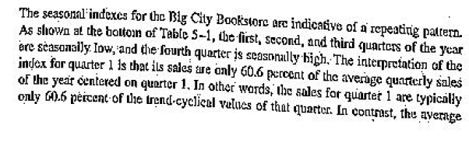

Slide 41
